Slide 1
A Guided Investment Platform for First-Time Investors: Initial Experiment & Evaluation Setup

Slide 2
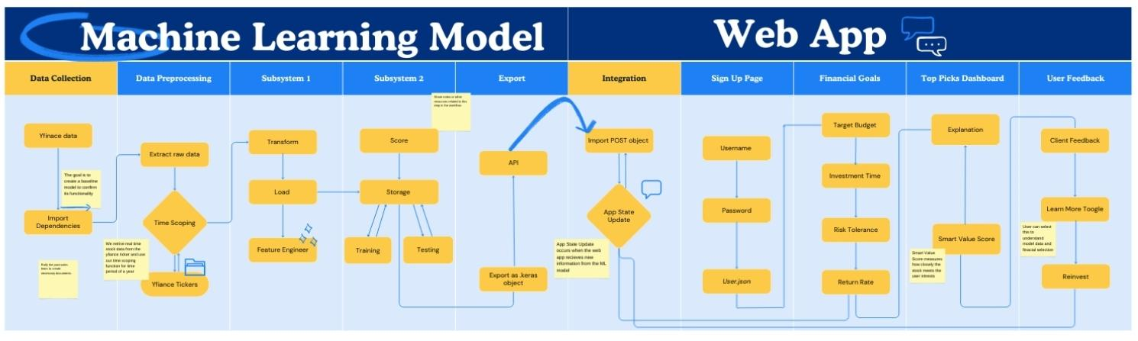
System Architecture
insert system design diagram
Notes:
Correct installation, dataset selection, and justification of environment and platform choices.

Slide 3
Model: Pipeline Components
Data Preparation:
Model Setup:
Pull stock data from yfinance
Combine data into a dataset
Clean, sort, & label
Use default settings
Set unit count, dropout, & batch size
Format & generate model summary
Training Process:
Evaluation & Visualization:
Trained the model for 20 epochs
Watched the accuracy and loss relationship
Verify that the model trains
Save the training history
Plot accuracy across epochs
Plot loss across epochs
Used as baseline reference

Slide 4
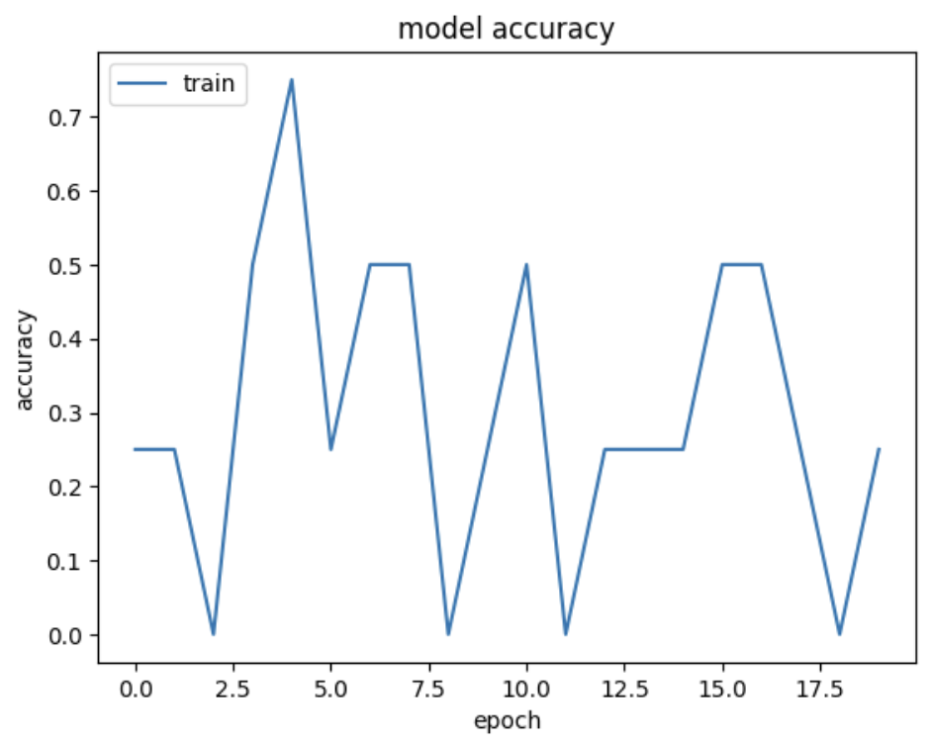
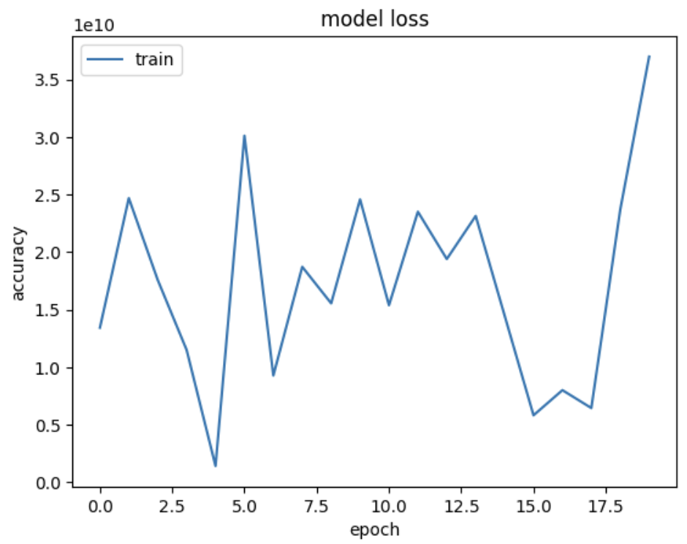
Baseline implementation
What we did:
Set up the first working version of the model pipeline
Used default values for unit count, dropout, and batch size
Baseline Training Accuracy Across Epochs
Baseline Training Loss Across Epochs

Slide 5
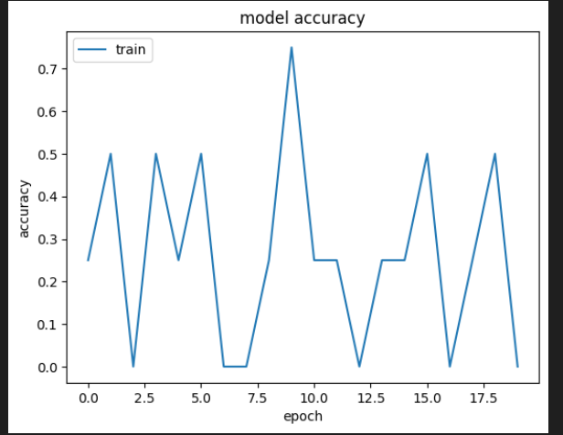
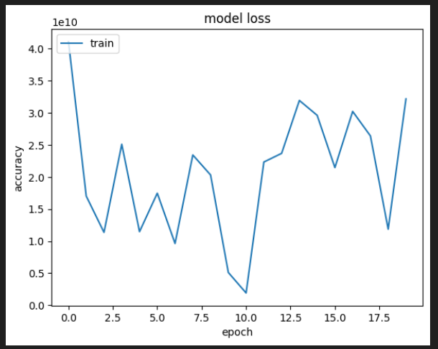
Experimental implementation
What we did:
Set up variant version of original model pipeline
Used (64,128,0.45) for unit count, dropout, and batch size
Experimental Training Accuracy Across Epochs
Experimental Training Loss Across Epochs

Slide 6
Experiment 1 Summary:
data used/findings
Baseline Model
  Test Accuracy: 50%
  Model’s loss peaks at an accuracy of 70% at epoch 2.4
Experimental Model
  Test Accuracy: 50%
  Model’s loss peaks at an accuracy of 80% at epoch 9.8
Discovered that both models used the same amount of memory resources when regardless of the network parameters provided
Notes:
Early experiment showing initial results or trends motivating the full study.

Slide 7
Positives
Negatives
Pipeline:
Pipeline successfully runs with no errors
Model produces a full summary
Trains for all 20 epochs without interruption
Experiments:
No crashes, shape mismatches, or preprocessing failures
Graph outputs generated
Baseline:
Accuracy/loss graphs
Framework:
Model parameters are easily adjustable
Experiments:
Nonlinearity of results causes difficulty in interpreting model’s reactions
Reproducibility was deemed difficult due to semantics involving virtual environment setup
Engineered dataset was minimized due to extensive effort when creating pipeline

